Slide 1
E-Gram Panchayath Kumara V.

Slide 2
TABLE OF CONTENTS
Introduction & Objective
Technology
Project planning
Analysis (DFDs, ER Diagram.)
Code, GUI, Database Tables
Future Scope
Conclusion

Slide 3
PROJECT SUMMARY
E-Gram Panchayath is a web application that is specially designed to establish an environment, wherein village public can easily communicate with the village councils.

Slide 4
OBJECTIVE
This project is aimed at achieving the solution for the problems that are faced by the public in villages, through this application public can easily contact PDO regarding any issues such as availing for services, complaints and certificates.
PDO (panchayath development officer) can easily monitor/track on the village problems and managements.

Slide 5




TECNOLOGY USED
Programming language : Python
Web framework : Django Web framework
Database : SQLite
Front end : HTML5, Boot Strap (CSS)

Slide 6
TECHNOLOGY BRIEF
Python
Python is a high-level, general purpose programming language, Python is commonly used for developing websites and softwares and data analysis.
Django
Django is a python based web framework that follows MVT architectural pattern, that encourages rapid development and clean, programmatic design.
SQLite
SQLite is a C-language library that implements a small, fast, self-contained, high-reliability, full featured, SQL database engine.

Slide 7
PLANNING - ROADMAP
Feasibility Study
Coding
Documentation
1
3
5
2
4
6
Design
Testing and Debug
Release website

Slide 8
PLANNING - GANTT CHART
 | Week 1 |  |  |  |  |  |  | Week 2
 | w1 | w2 | w3 | w4 | w5 | w6 | w7 | w8 | w9 | w10 | w11 | W12 | W13 | w14
Task 1 | Problem Study
Task 2 |  | Feasibility Study |  |  |  | ◆
Task 3 |  |  | System Analysis
Task 4 |  |  |  |  |  |  | Sytem Design |  |  |  | ◆
Task 5 |  |  |  |  |  |  |  | System Coding | ◆
Task 6 |  |  |  |  |  |  |  |  | Testing and Debugging
Task 7 |  |  |  |  |  |  |  |  |  |  | Documentation
Task 8 |  |  |  |  |  |  |  |  |  |  |  | Implementation

Slide 9
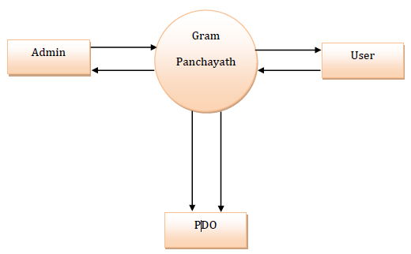
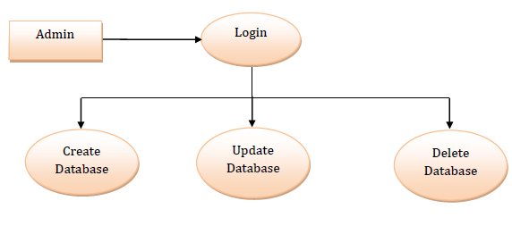
ANALYSIS – DFDs L0
Admin level DFD
Context level diagram

Slide 10
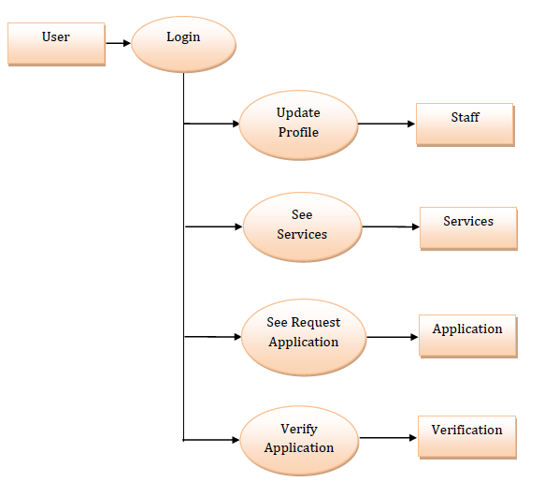
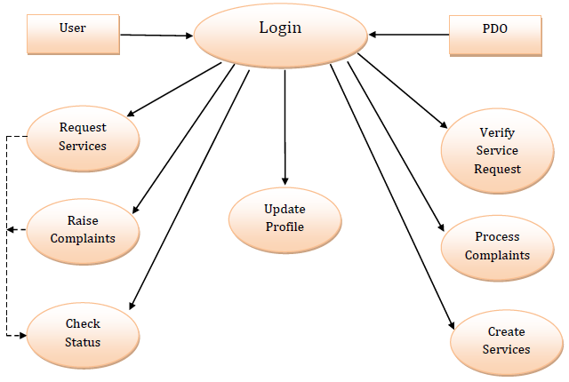
ANALYSIS – DFDs L1, L2
User level1 diagram
User and PDO level2 DFD

Slide 11
ER DIAGRAM
Pwd
email
id
Admin
name
manages
name
id
Pwd
Pwd
id
email
PDO
User
name
date
cmp
name
email
Serv
name
Apply/Raise
ER Model
An entity-relationship model describes interrelated things of interest in a specific domain of knowledge.
A basic ER model is composed of entity types (which classify the things of interest) and specify relationships that can exist between the entities.
date
for
doc
Service
Complaint
Certificate
type
type
doc
img
Verify
Rejected
Application
Completed

Slide 12
CODE SAMPLE
Login Functionality
def login_user(request): if request.method == ‘POST’: uname = request.POST.get(‘uname’) pwd = request.POST.get(‘pwd’) user = authenticate(uname, pwd) if user is not None: login(request, user) else: messages.warning(request, “Uname and Pwd is Invalid”) return render(request, ‘Login.html’)
Password Change Functionality
If request.method == ‘POST’: form = UserPwdForm(request.user, request.POST) if form.is_valid(): form.save() messages.success(request, f“your pwd changes successfully”) return redirect(‘Login’) else: form = UserPwdForm(request.user)
Process Request Functionality
Class Processrequest(DetailView): model = Services template_name_suffix = ‘_process_request_details’ def get_context-data(self, **kwargs): context = super().get_context_data(**kwargs) return context

Slide 13
Certificate Table
DATABASE
Column Name | Column Type | Condition
Certificate Type | Char Field | Max length = 20
Certificate Name | Char Field
Father Name | Char Field | Max length = 20
Mother Name | Char Field | Max length = 20
Address | Text Field
Govt id | Char Field
Govt Proof Document | File Field
Birth Date | Date Field
Death Date | Date Field
Death Location | Char Field | Max length = 20
Caste | Char Field | Max length = 20
Caste Category | Char Field
Income Value | Char Field
Document Proof | File Field
Remarks | Text Field
Approval Status | Char Field | Max length = 20

Slide 14
DATABASE
Service Table
User Table
Column Name | Column Type | Condition
Service Type | Char Field | Max length = 20
Service Name | Char Field
Service Applied Date | Date Field
Service Description | Text Field
Service Applied By | One to One Field
Serv Request Image | Image Field
Serv Remarks | Text Field | Max length = 100
Estimated Completion Date | Date Field | Max length = 20
Completion Status | Char Field | Max length = 20
Serv Completion Image | Image Field
Serv Doc Name | Char Field
Serv Doc File | File Field
Column Name | Column Type | Condition
User Name | Char Field | Max length = 150
First Name | Char Field | Max length = 150
Email | Email Field
Password | Char Field | Max length = 40
Groups | Char Field
User Permission | Char Field | Null = True
Is Staff | Boolean Field | Null = True
Is Super User | Boolean Field | Null = True
Last Login | Date Field | Time Zone
Date Joined | Date Time Field | Default = time zone

Slide 15
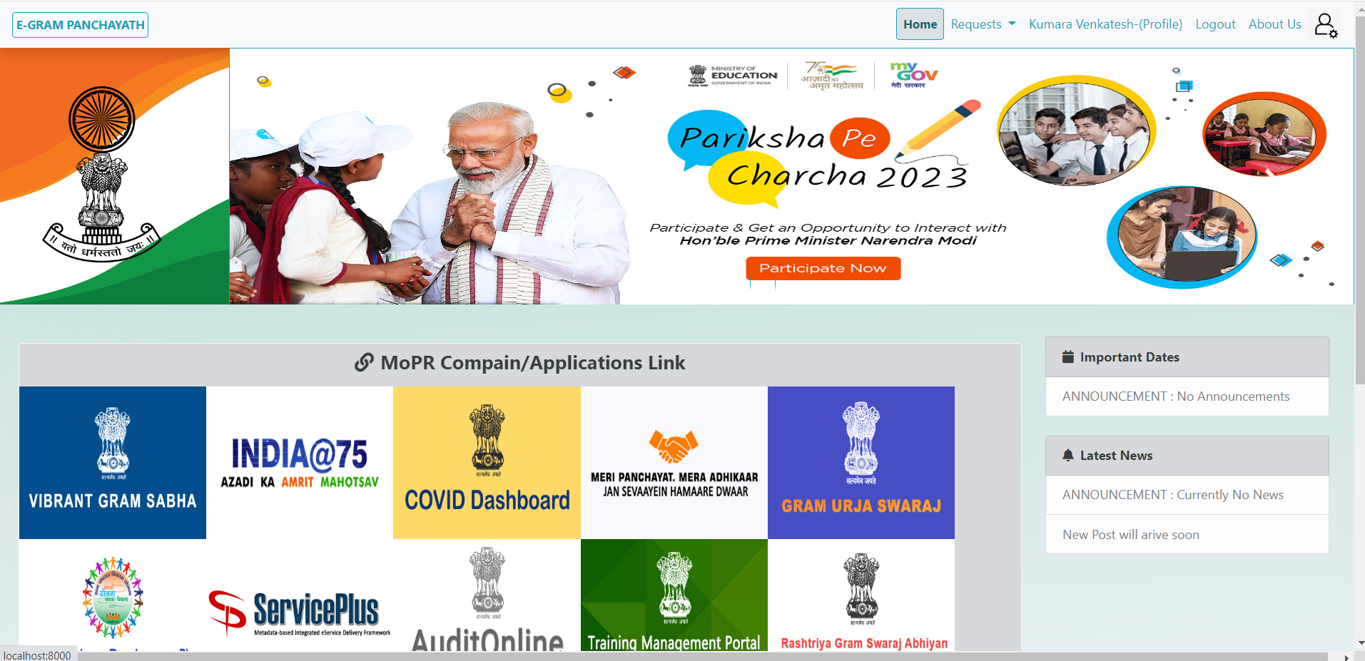
Home Page
GUI

Slide 16
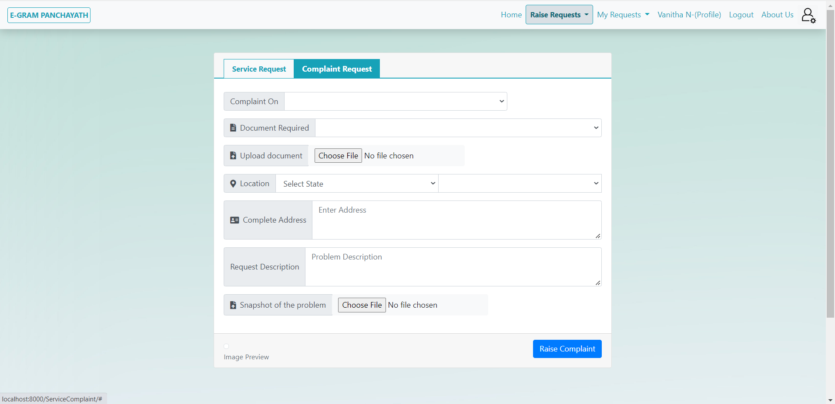
Complaint Request Page
GUI

Slide 17
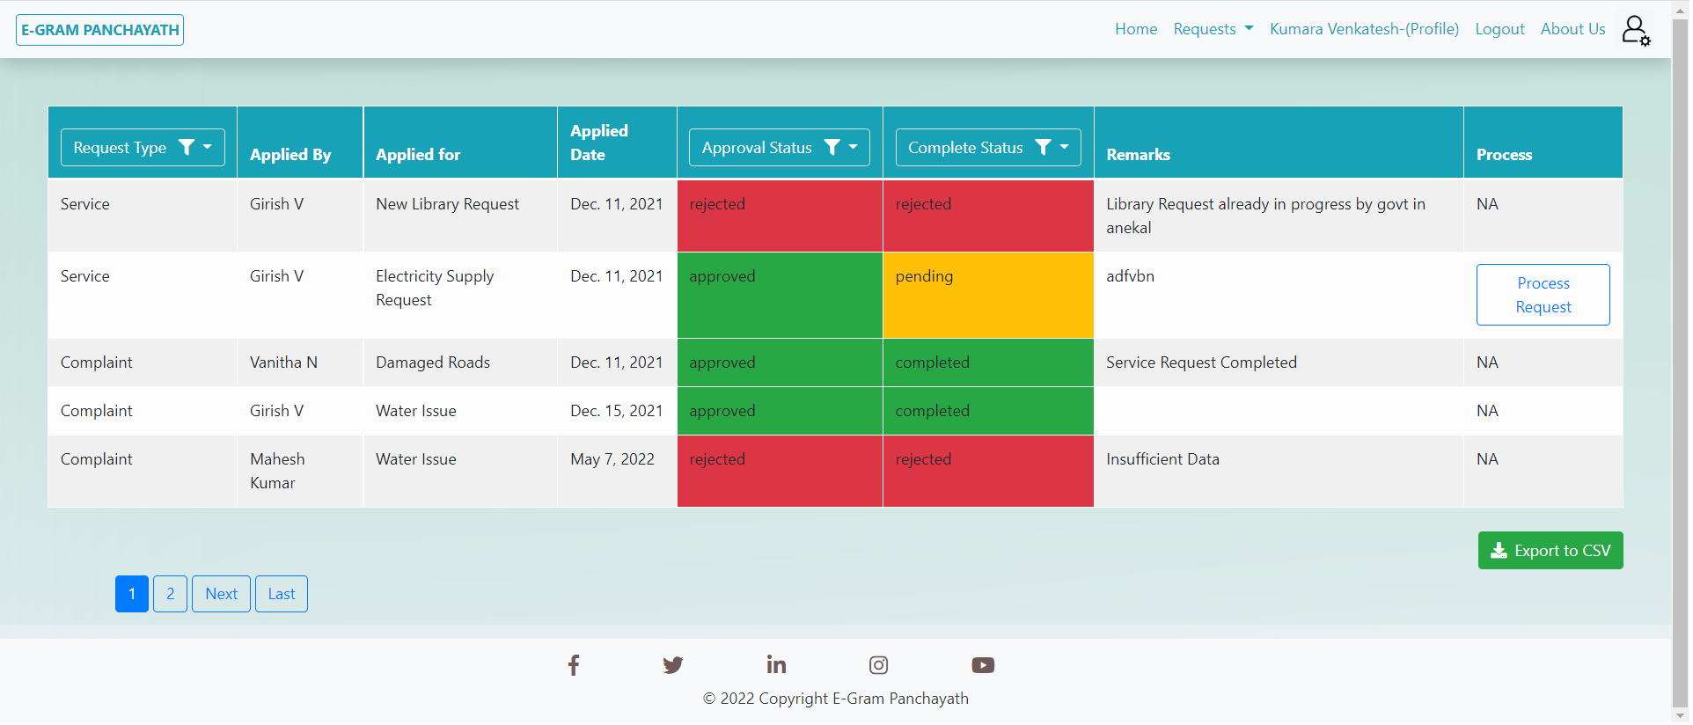
PDO Requests Page
GUI

Slide 18
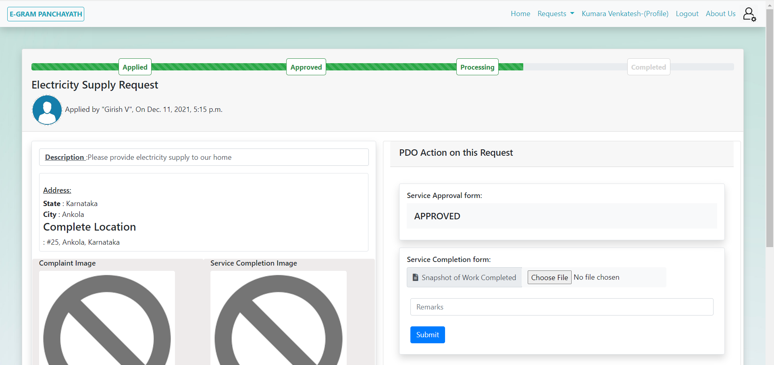
Service Process Page
GUI

Slide 19
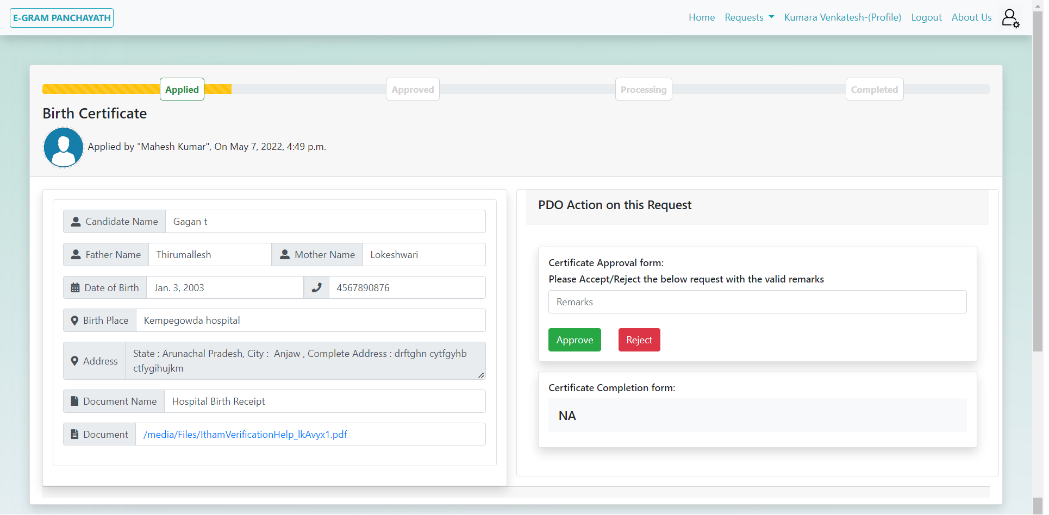
Certificate Process Page
GUI

Slide 20
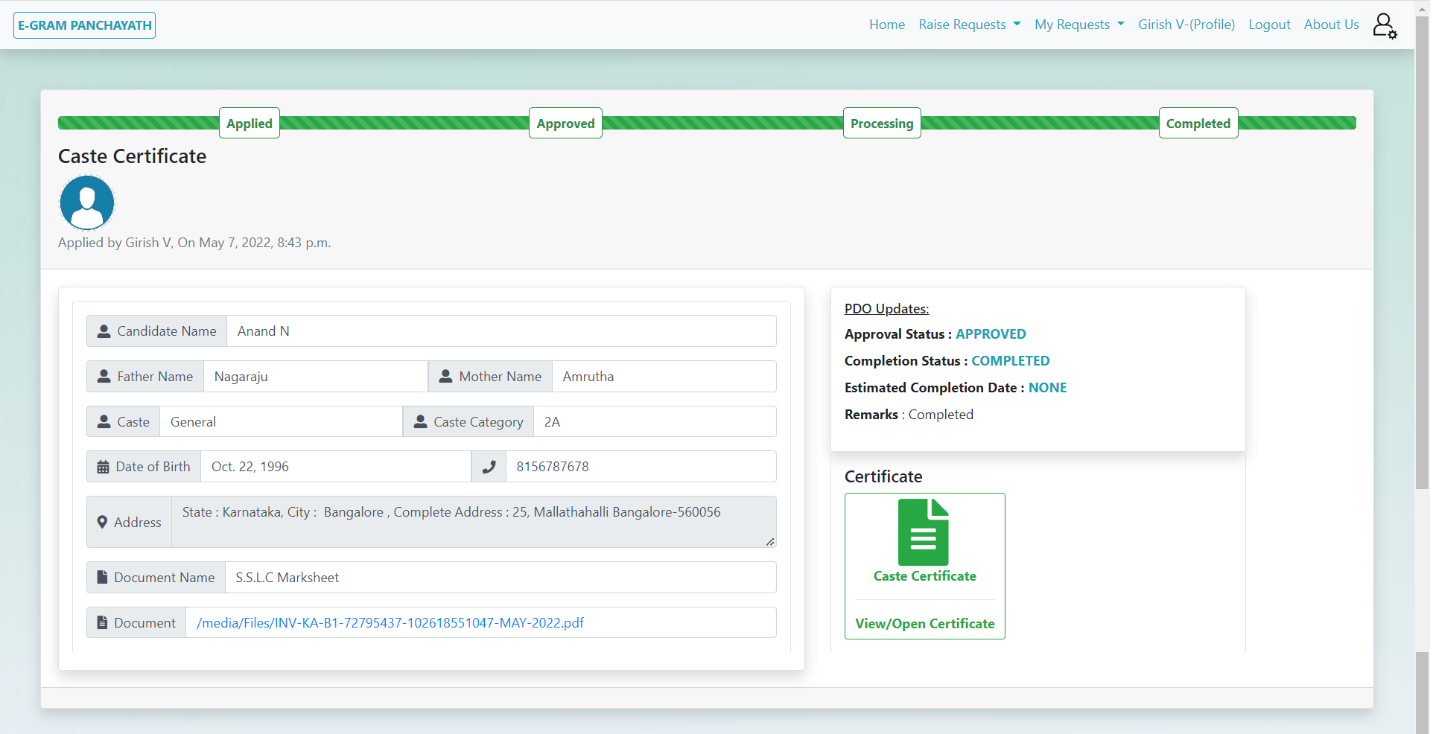
Request Details Page
GUI

Slide 21
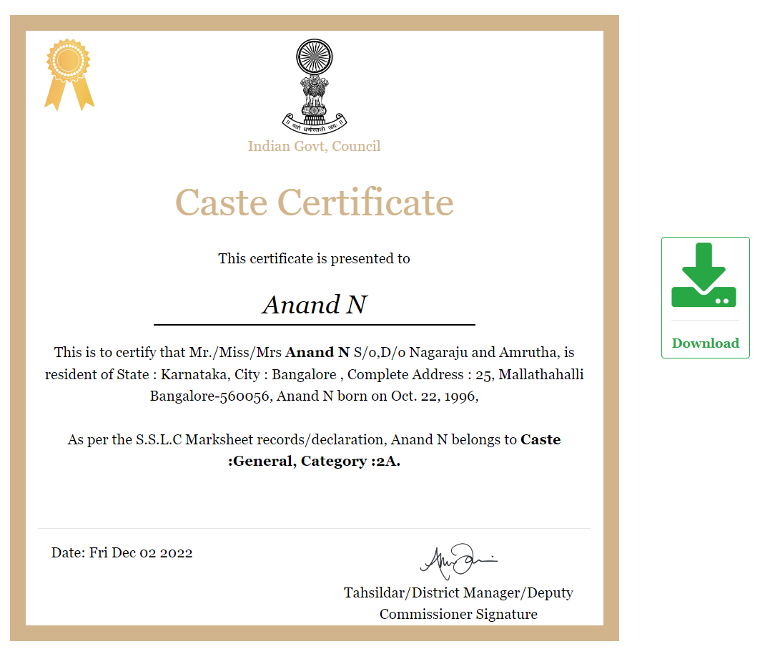
Certificate Download Page
GUI

Slide 22
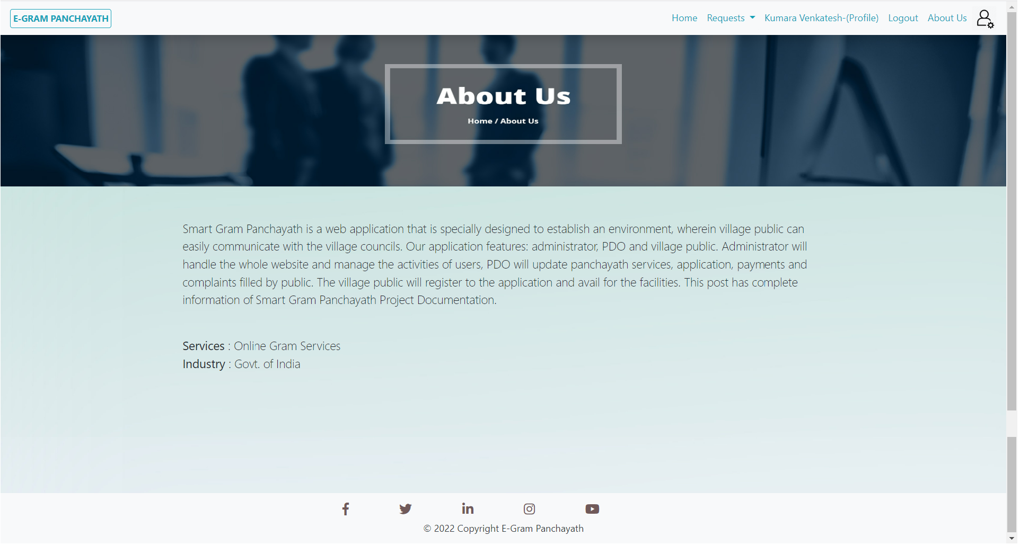
About Us Page
GUI

Slide 23
FUTURE SCOPE
This project has more scope in future and it can be integrated further.
This project can be implemented for AI based voice assist to raise request/service through voice in user language (it’s for illiterate, blinds).
This project currently available as website, it can be implemented for Mobile applications, tabs, etc.
Can be enhanced to common application for all village development programs.

Slide 24
CONCLUSION
E-Governance for panchayath provides online service to the people living in that panchayath, it helps for the people in the area to easily complete their work which involves the action of authority of the panchayath people,
As everything is made online people can request their applications from anywhere at any time. After requesting the certificate/Service the process will be carried out normally, no need for the people to go to panchayath office every time for the completion of work, people can track there request online, It saves time and helps track of the village development activities.

Slide 25
THANKS!
Any questions?

